Slide 1
Current State of Japanese Economy under Negative Interest Rate and
Proposed Remedies
Naoyuki Yoshino
Dean Asian Development Bank Institute
Professor Emeritus, Keio University, Japan
Chair Person, JGB Investors Meeting, MOF
Senior Advisor, Financial Research Institute, FSA

Slide 8
Flow of
Funds in
Japan
2015

Slide 9
Monetary policy during high growth period
1, Shortage of funding by companies
2, Savings→Bank deposits→Loans to corporations
3, BOJ → Discount window → BOJ loans to banks
4, Banks → Loan to corporations
5, In recession, BOJ loans to banks increased
6, In boom, BOJ reduced loans to banks

Slide 10
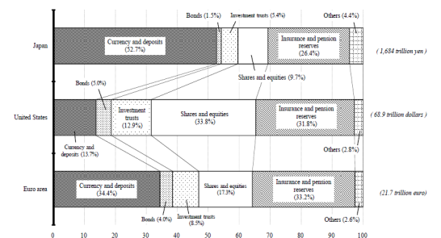
Households’ Asset Allocation (USA, JAPAN, Europe)

Slide 13
Population Aging of Japan
Current Figures
Forecast
(2012)
Peak of the Population
2004, 127.8 million
10 of Thousands
Source：Ministry of Internal
Affairs and Communication
FY

Slide 14
Households’ Savings Ratio

Slide 15
Financial Assets by Age
 | Deposits | Insurance | Securities | Others | Total
Average | 635 | 303 | 179 | 52 | 1169
20years | 266 | 26 | 40 | 10 | 342
30years | 298 | 122 | 77 | 40 | 537
40years | 355 | 241 | 85 | 62 | 743
50years | 533 | 344 | 126 | 65 | 1068
60years | 811 | 409 | 276 | 43 | 1539
70years | 1035 | 333 | 287 | 52 | 1707

Slide 16
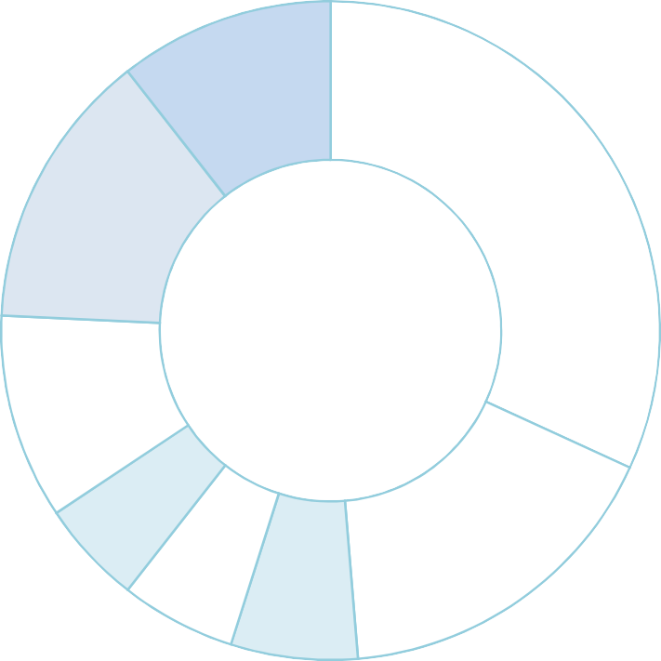
General Account Budget -Breakdown of Expenditure
National Debt Service 23,270.2
24.3%
Interest Payments 10,131.9
10.6%
Redemption of the National Debt 13,138.3
13.7%
Social Security 30,517.5
31.8%
General Account
Total Expenditures 95,882.3
(100.0%)
Primary Expenses 72,612.1
75.7%
Others 9,656.8
10.1%
National Defense 4,884.8
5.1%
Local Allocation Tax Grants, etc.
161,424
16.8%
Public Works 5,968.5
Education & Science 5,442.1
5.7%
6.2%
Food Supply | 1,050.7 | (1.1)
Promotion of SMEs | 185.3 | (0.2)
Energy | 964.2 | (1.0)
Former Military Personal Pensions | 444.3 | (0.5)
Economic Assistance | 509.8 | (0.5)
Miscellaneous | 6,152.6 | (6.4)
Contingency Reserves | 350.0 | (0.4)
（Note1）Figures may not add up to the totals due to rounding.
（Note2）The ratio of Social Security expenses to General Expenditures*：54.0%
*General Expenditures equals to the Primary Expenditure minus Local Allocation Tax Grants, etc.

Slide 17
Banks and Postal Savings (2015) JAPAN | 27.8%
Bank of Japan (2015) JAPAN | 21.2%
Life and Non-life Insurances (2015) | 19.3%
Overseas’ Investors (2015) | 8.5%
Public Pension funds (2015) | 6.4%
Private Pension Funds (2015) | 3.4%

Slide 21
Yoshino and Sakakibara (2002) “The Current State of Japanese Economy and Remedies”,
Asian Economic Papers, MIT Press, Vol.1, No.2.

Slide 22
Yoshino, N., Taghizadeh-Hesary, F. (2015), ‘An Analysis of Challenges Faced by Japan’s Economy and Abenomics’. Journal of Japanese Political Economy. Routledge: Taylor and Francis, DOI: 10.1080/2329194X.2014.998591
Yoshino, N., Taghizadeh-Hesary, F. (2016). ‘Causes and Remedies of Japan’s Long Lasting Recession: Lessons for China’. China & World Economy. Vol 24 (2): 2016

Slide 23
Reasons for Vertical IS curve

Slide 24
Domar Condition

Slide 26
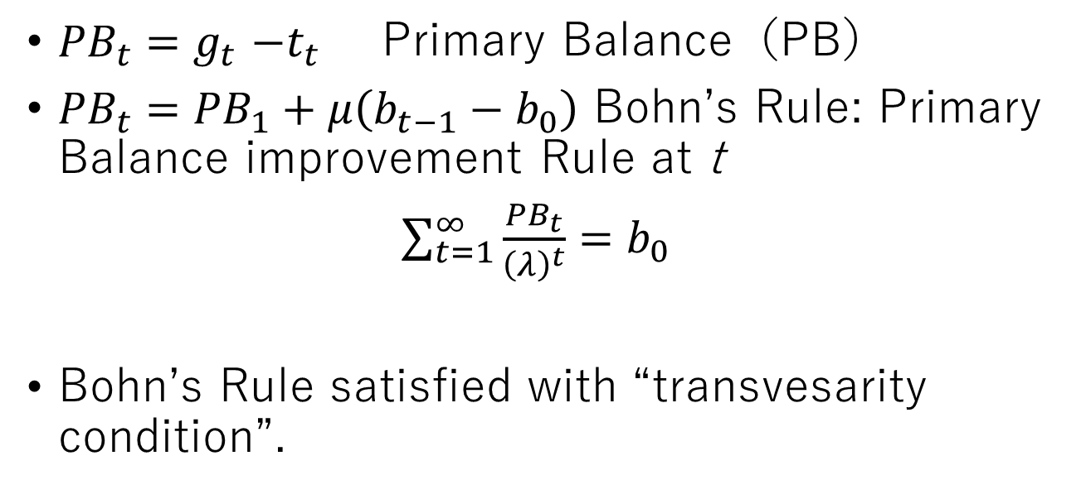
Bohn’s Condition
${PB}_{t}{=g}_{t}−t_{t}$ Primary Balance（PB）
${PB}_{t}={PB}_{1}+μ\left(b_{t−1}−b_{0}\right)$ Bohn’s Rule: Primary Balance improvement Rule at t
$\sum_{t=1}^{∞}{\frac{{PB}_{t}}{{\left(λ\right)}^{t}}}=b_{0}$
Bohn’s Rule satisfied with “transvesarity condition”.

Slide 28
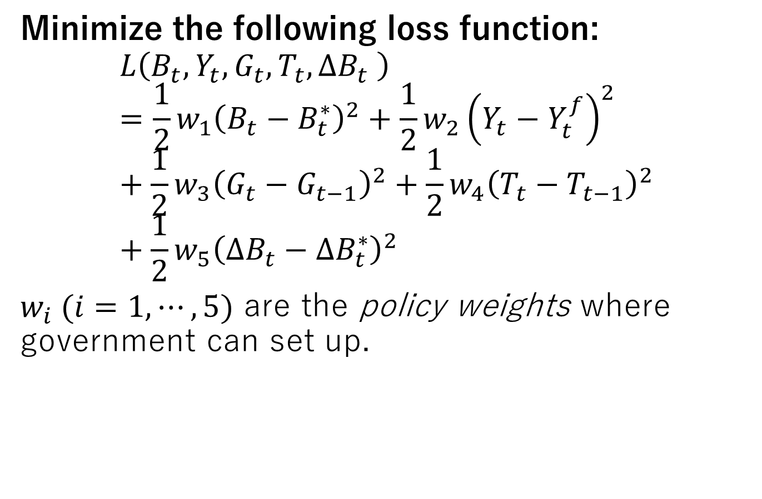
Objective Loss Function of the Government
Minimize the following loss function:
$$L\left(B_{t},Y_{t},G_{t},T_{t},∆B_{t} \right)=\frac{1}{2}w_{1}{\left(B_{t}−B_{t}^{∗}\right)}^{2}+\frac{1}{2}w_{2}{\left(Y_{t}−Y_{t}^{f}\right)}^{2}+\frac{1}{2}w_{3}{\left(G_{t}−G_{t−1}\right)}^{2}+\frac{1}{2}w_{4}{\left(T_{t}−T_{t−1}\right)}^{2}+\frac{1}{2}w_{5}{\left(∆B_{t}−{∆B}_{t}^{∗}\right)}^{2}$$
$w_{i} (i=1,⋯,5)$ are the policy weights where government can set up.

Slide 31
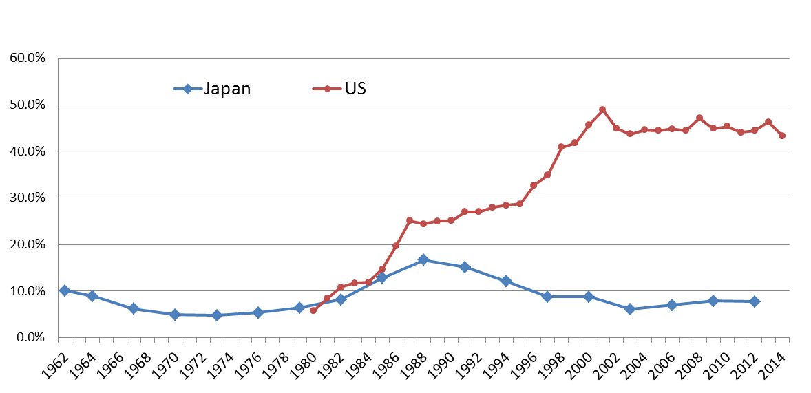
Percentage of US and Japanese household
Investment trusts and Mutual Funds

Slide 32
Fees and Commissions of Distributors
Maximize Fee and Commissions (Distributors)
Investors --- maximize Return
Trust Fees & Commissions= α（A＋Dividend)
Trust Fees and
Commissions
MAX Return
Investors
Distributors
Banks
Securities companies
Asset Management
Company

Slide 35
High
Volatility of
Stock
Market
Large
Share of overseas’
Investors

Slide 37
Rate of Return on Pension Funds

Slide 38
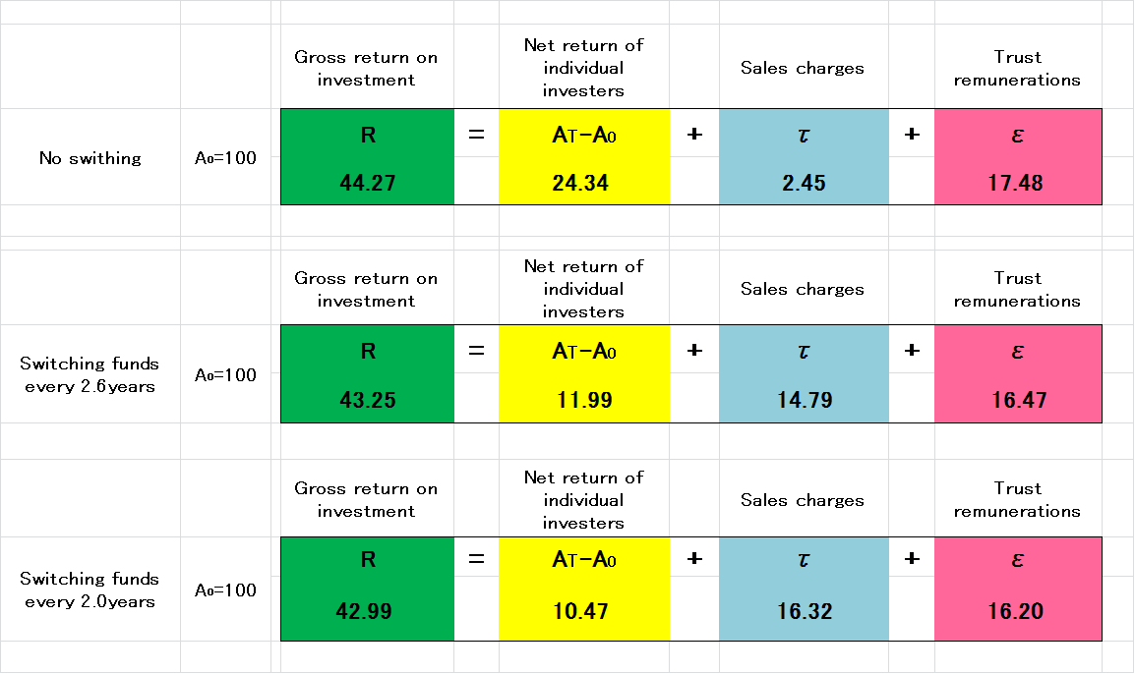
Mutual Funds – Holding Period
Fee Structure is important

Slide 39
City Banks Regional Banks

Slide 40
Declining Bank Loans

Slide 41
Declining effectiveness of Fiscal Policy
 |  | 1956-60 | 1961-65 | 1966-70 | 1971-75 | 1976-80 | 1981-85
Direct Effect (Kg) |  | 0.696 | 0.737 | 0.638 | 0.508 | 0.359 | 0.275
Indirect Effect (Kp) |  | 0.453 | 0.553 | 0.488 | 0.418 | 0.304 | 0.226
Indirect Effect (L) |  | 1.071 | 0.907 | 0.740 | 0.580 | 0.407 | 0.317
1986-90 | 1991-95 | 1996-00 | 2001-05 | 2006-10
0.215 | 0.181 | 0.135 | 0.114 | 0.108
0.195 | 0.162 | 0.122 | 0.1 | 0.1
0.193 | 0.155 | 0.105 | 0.09 | 0.085

Slide 42


Possible Solutions
Start up businesses, farmers
Hometown Investment
Trust Funds
--------------------------------------------------
A Stable Way to Supply Risk Capital
Yoshino, Naoyuki; Kaji Sahoko (Eds.)
2013, IX, 98 p. 41 illus.,20 illus. in color
Available Formats:
ebook
Hardcover Japan, Cambodia
Springer Vietnam, Peru

Slide 43
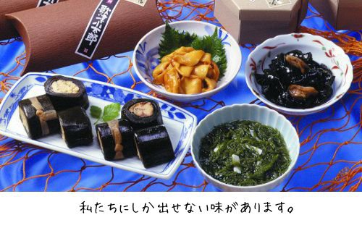
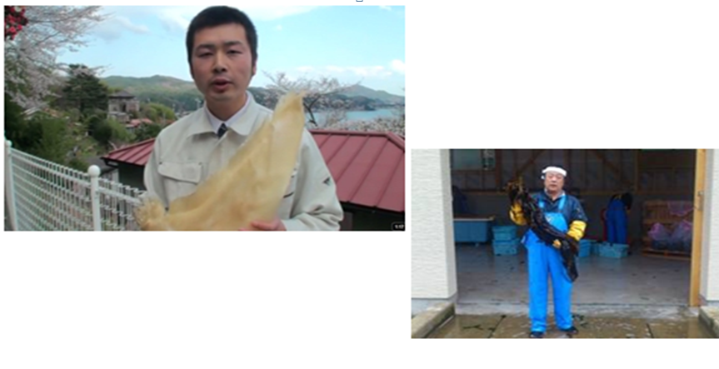
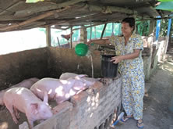
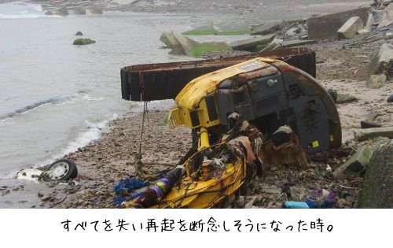

Investment in SMEs and start up businesses

Slide 44



Slide 45
Proposed remedies
Postpone retirement age
Abolish seniority wage rate
productivity based wage rate
(2) Productivity of white color must be increased
(3) Create incentives for local government
Hometown Investment Trust Funds
(4) Aging population of agricultural farmers
(5) BOJ, ECB, FED move together to tighten

Slide 48
References
McNelis, P and N, Yoshino (2012) “Macroeconomic Volatility under High Accumulation of Government Debt: Lessons from Japan”, Advances in Complex Systems, Vol.15, Suppl. No.2, pp.1250057-1-1250057-29.
Hoshi, T. and T. Ito (2014) “Defying Gravity: can Japanese sovereign debt continue to increase without a crisis?”, Economic Policy Journal, Vol.29, Iss.7, pp.5-44.
Yoshino, N. and E. Sakakibara (2002) “The Current State of Japanese Economy and Remedies”, Asian Economic Papers, Vol.1, No.2, MIT Pres
Yoshino, N. and T. Mizoguchi (2010) “The Role of Public Works in the Political Business Cycle and the Instability of the Budget Deficits in Japan”, Asian Economic Papers, Vol.9, No.1, pp. 94-112.
Yoshino, N. and T. Mizoguchi (2013a) “Change in the Flow of Funds and the Fiscal Rules Needed for Fiscal Stabilization”, Public Policy Review, Vol.8, No.6, pp.775-793.
Yoshino, N. and T. Mizoguchi (2013b) “Optimal Fiscal Policy Rule to Achieve Fiscal Sustainability: Comparison between Japan and Europe”, Presented at Singapore Economic Review Conference 2013.
Yoshino, N and U. Vollmer (2014) “The Sovereign Debt Crisis: Why Greece, but not Japan?”, Asia Europe Journal, June, Vol.12, Iss.3, pp.325-341.
Yoshino, N., Taghizadeh-Hesary, F. (2015), ‘An Analysis of Challenges Faced by Japan’s Economy and Abenomics’. Journal of Japanese Political Economy. Routledge: Taylor and Francis, DOI: 10.1080/2329194X.2014.998591
Yoshino, N., T. Mizoguchi and Taghizadeh-Hesary, F. (2015) “Optimal Fiscal Policy Rule for Achieving Fiscal Sustainability: A Japanese Case Study’, Asian Development Bank Institute, Working Paper, No. 531.
Yoshino, N., Taghizadeh-Hesary, F. (2016). ‘Causes and Remedies of Japan’s Long Lasting Recession: Lessons for China’. China & World Economy. Vol 24 (2): 2016

Slide 51
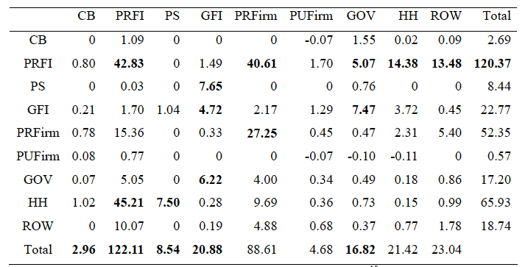
Financial Flow in Japan (1980－1990)

Slide 53


